Slide 1
Chapter 18 Objectives
Understand the order and purpose of each stage of the cell cycle
Be able to identify and describe the key features of each stage of the cell cycle
Understand the purpose of restriction points/checkpoints present in each stage of the cell cycle.
Be able to provide examples of how each checkpoint might be activated and what consequence checkpoint activation has for a cell
Understand the stages of Mitosis and how they contribute to accurate chromosome segregation

Slide 2
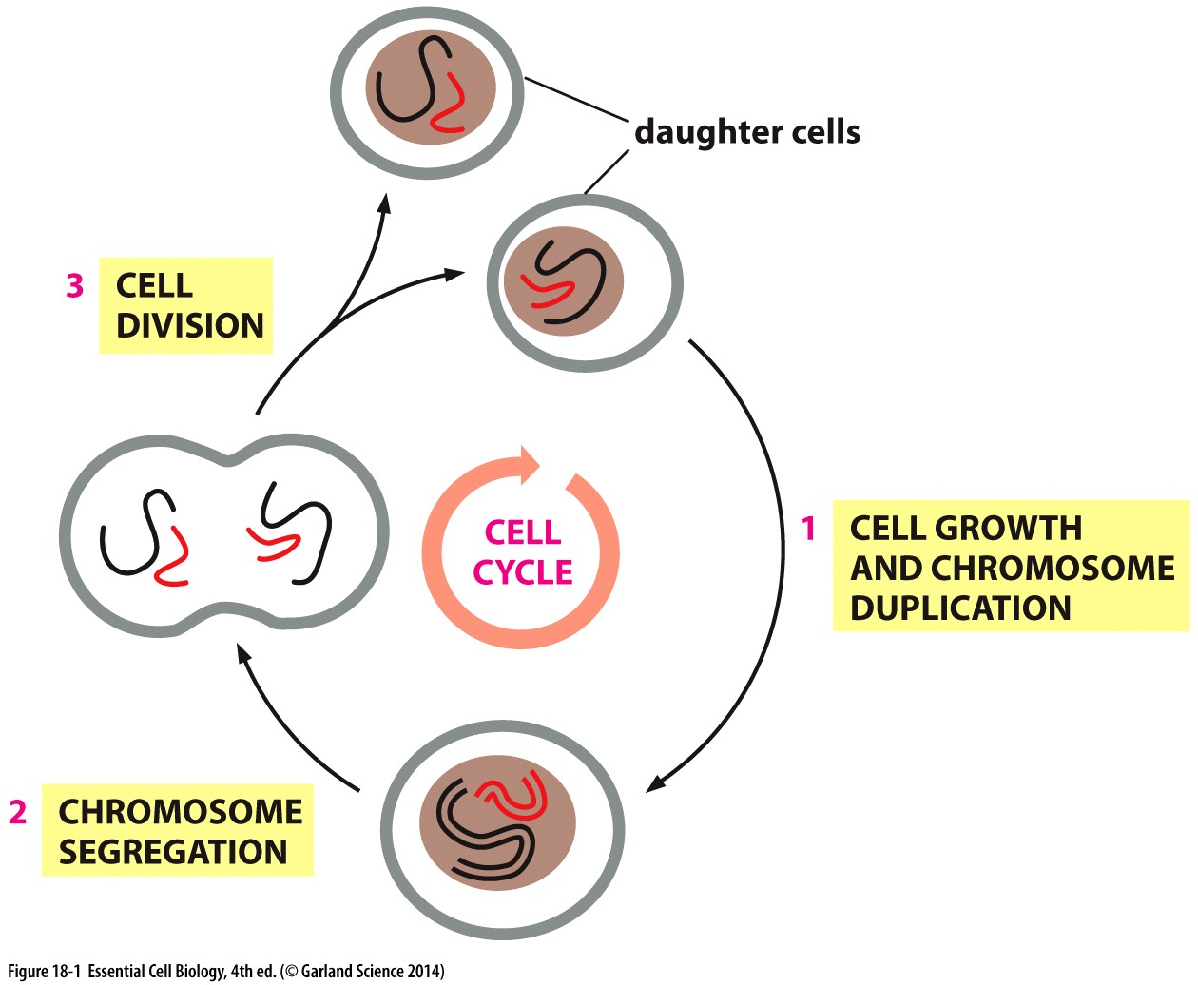
Phases of the cell cycle
Timing of cell cycle progression varies between organisms
~20min in bacteria
~1.5h in yeast
20+ hours in cultured human cells
WHY?

Slide 3
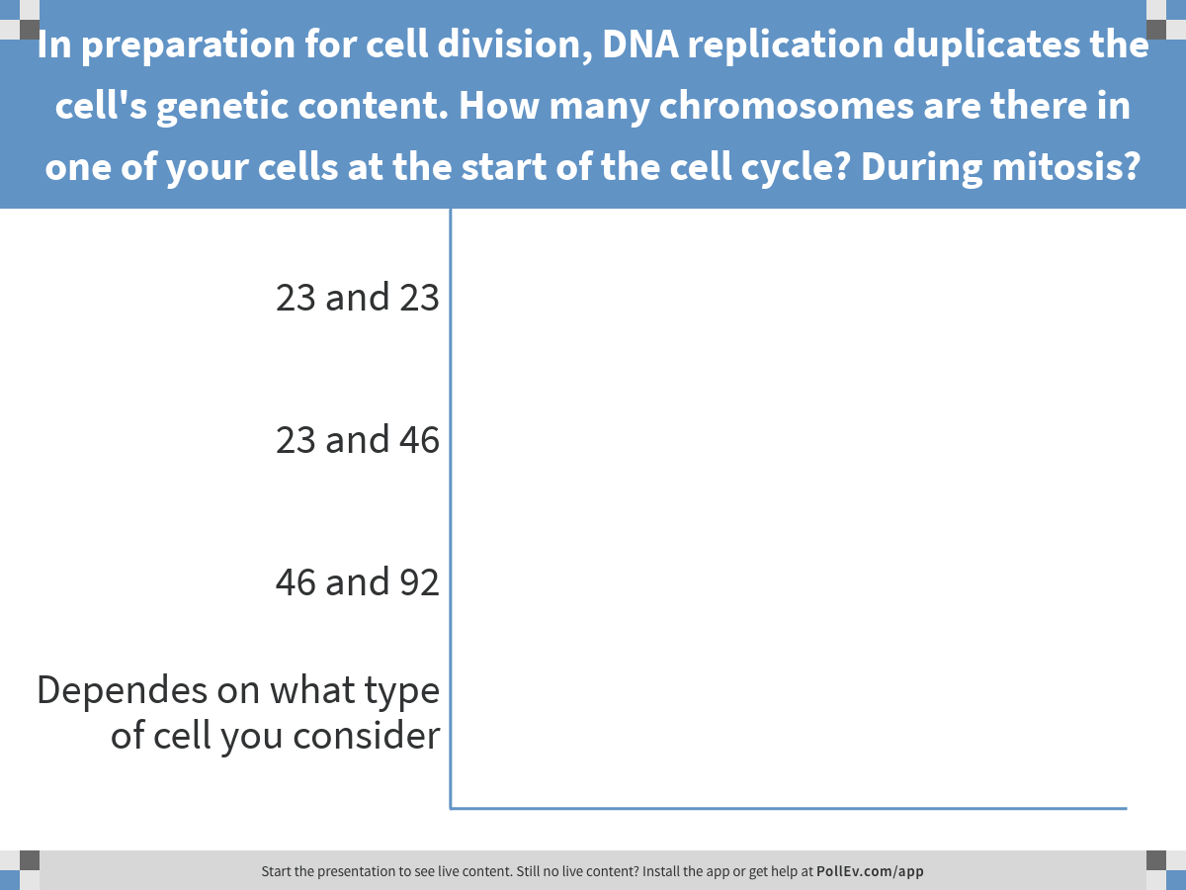
Notes:
In preparation for cell division, DNA replication duplicates the cell's genetic content. How many chromosomes are there in one of your cells at the start of the cell cycle? During mitosis?
https://www.polleverywhere.com/multiple_choice_polls/jWf0thb0mJ0VFpI

Slide 4
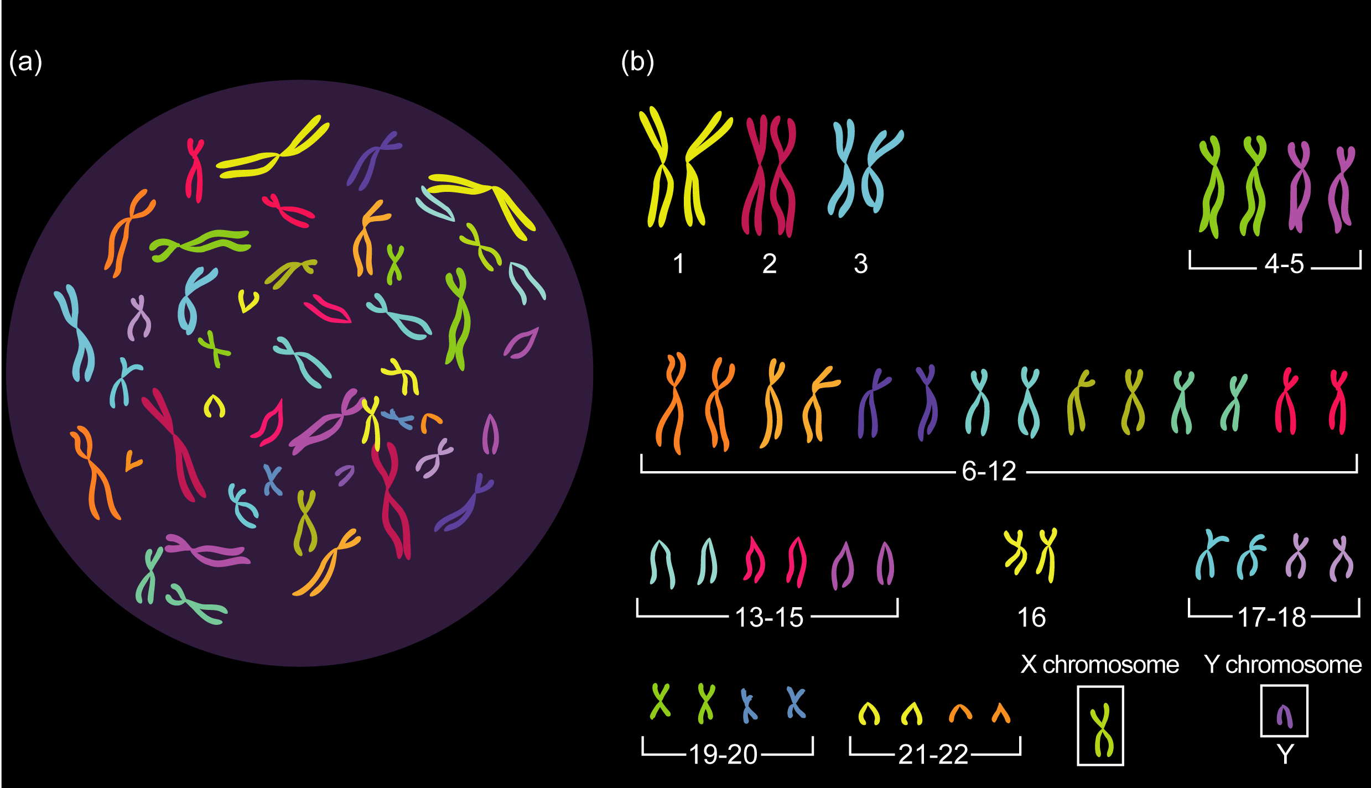

Slide 5
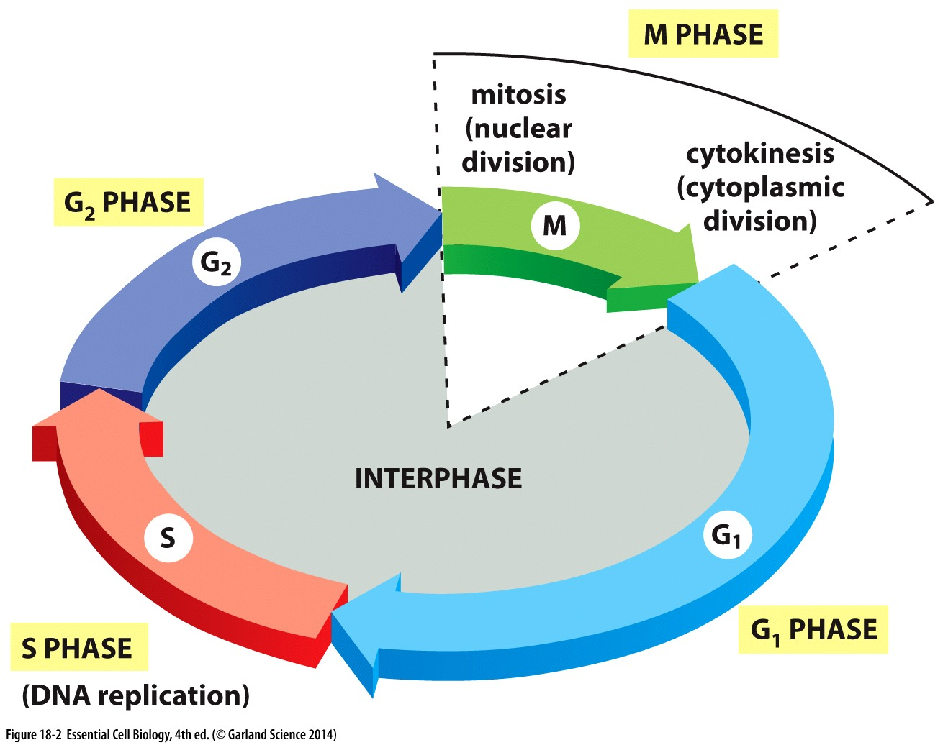
Time is not divided equally among phases
For a cell that divides once every 24 hours:
~1 hour
~4 hours
Interphase:
G1 + S + G2
Mitosis
has sub-stages
~8-10 hours
~10 hours

Slide 6
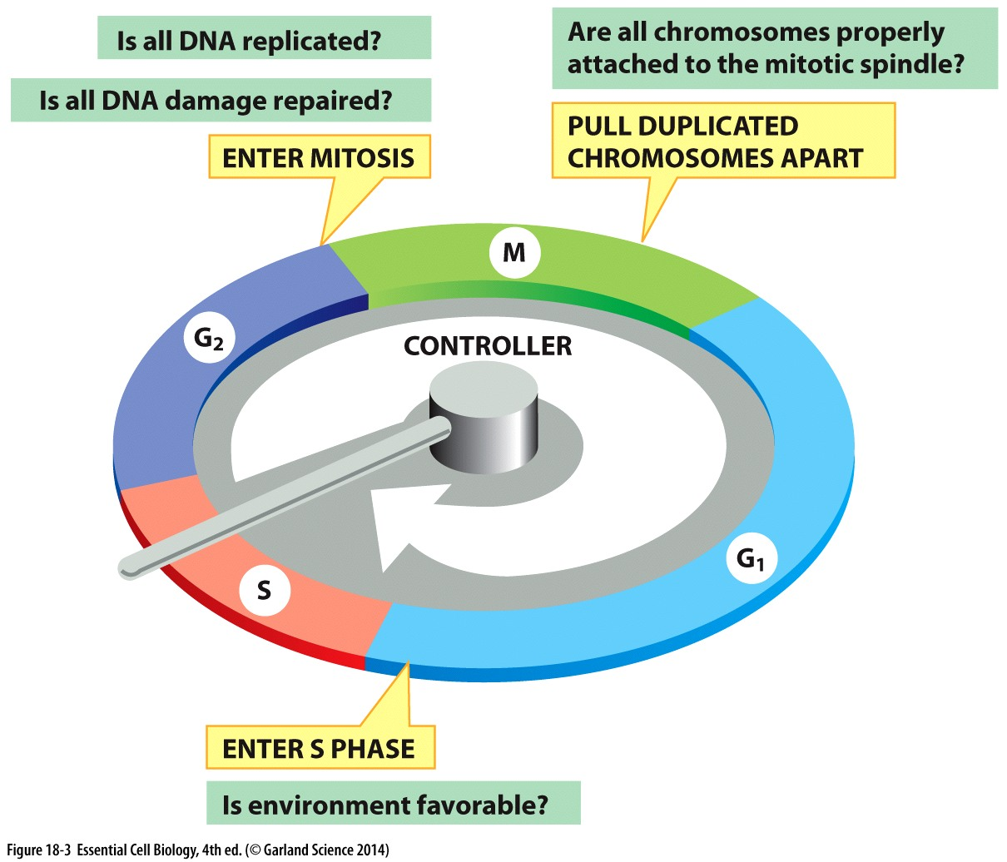
Checkpoints regulate when/if cell cycle progresses
In absence of checkpoint activation,
Progression is regulated by synthesis and destruction of cyclins

Slide 7
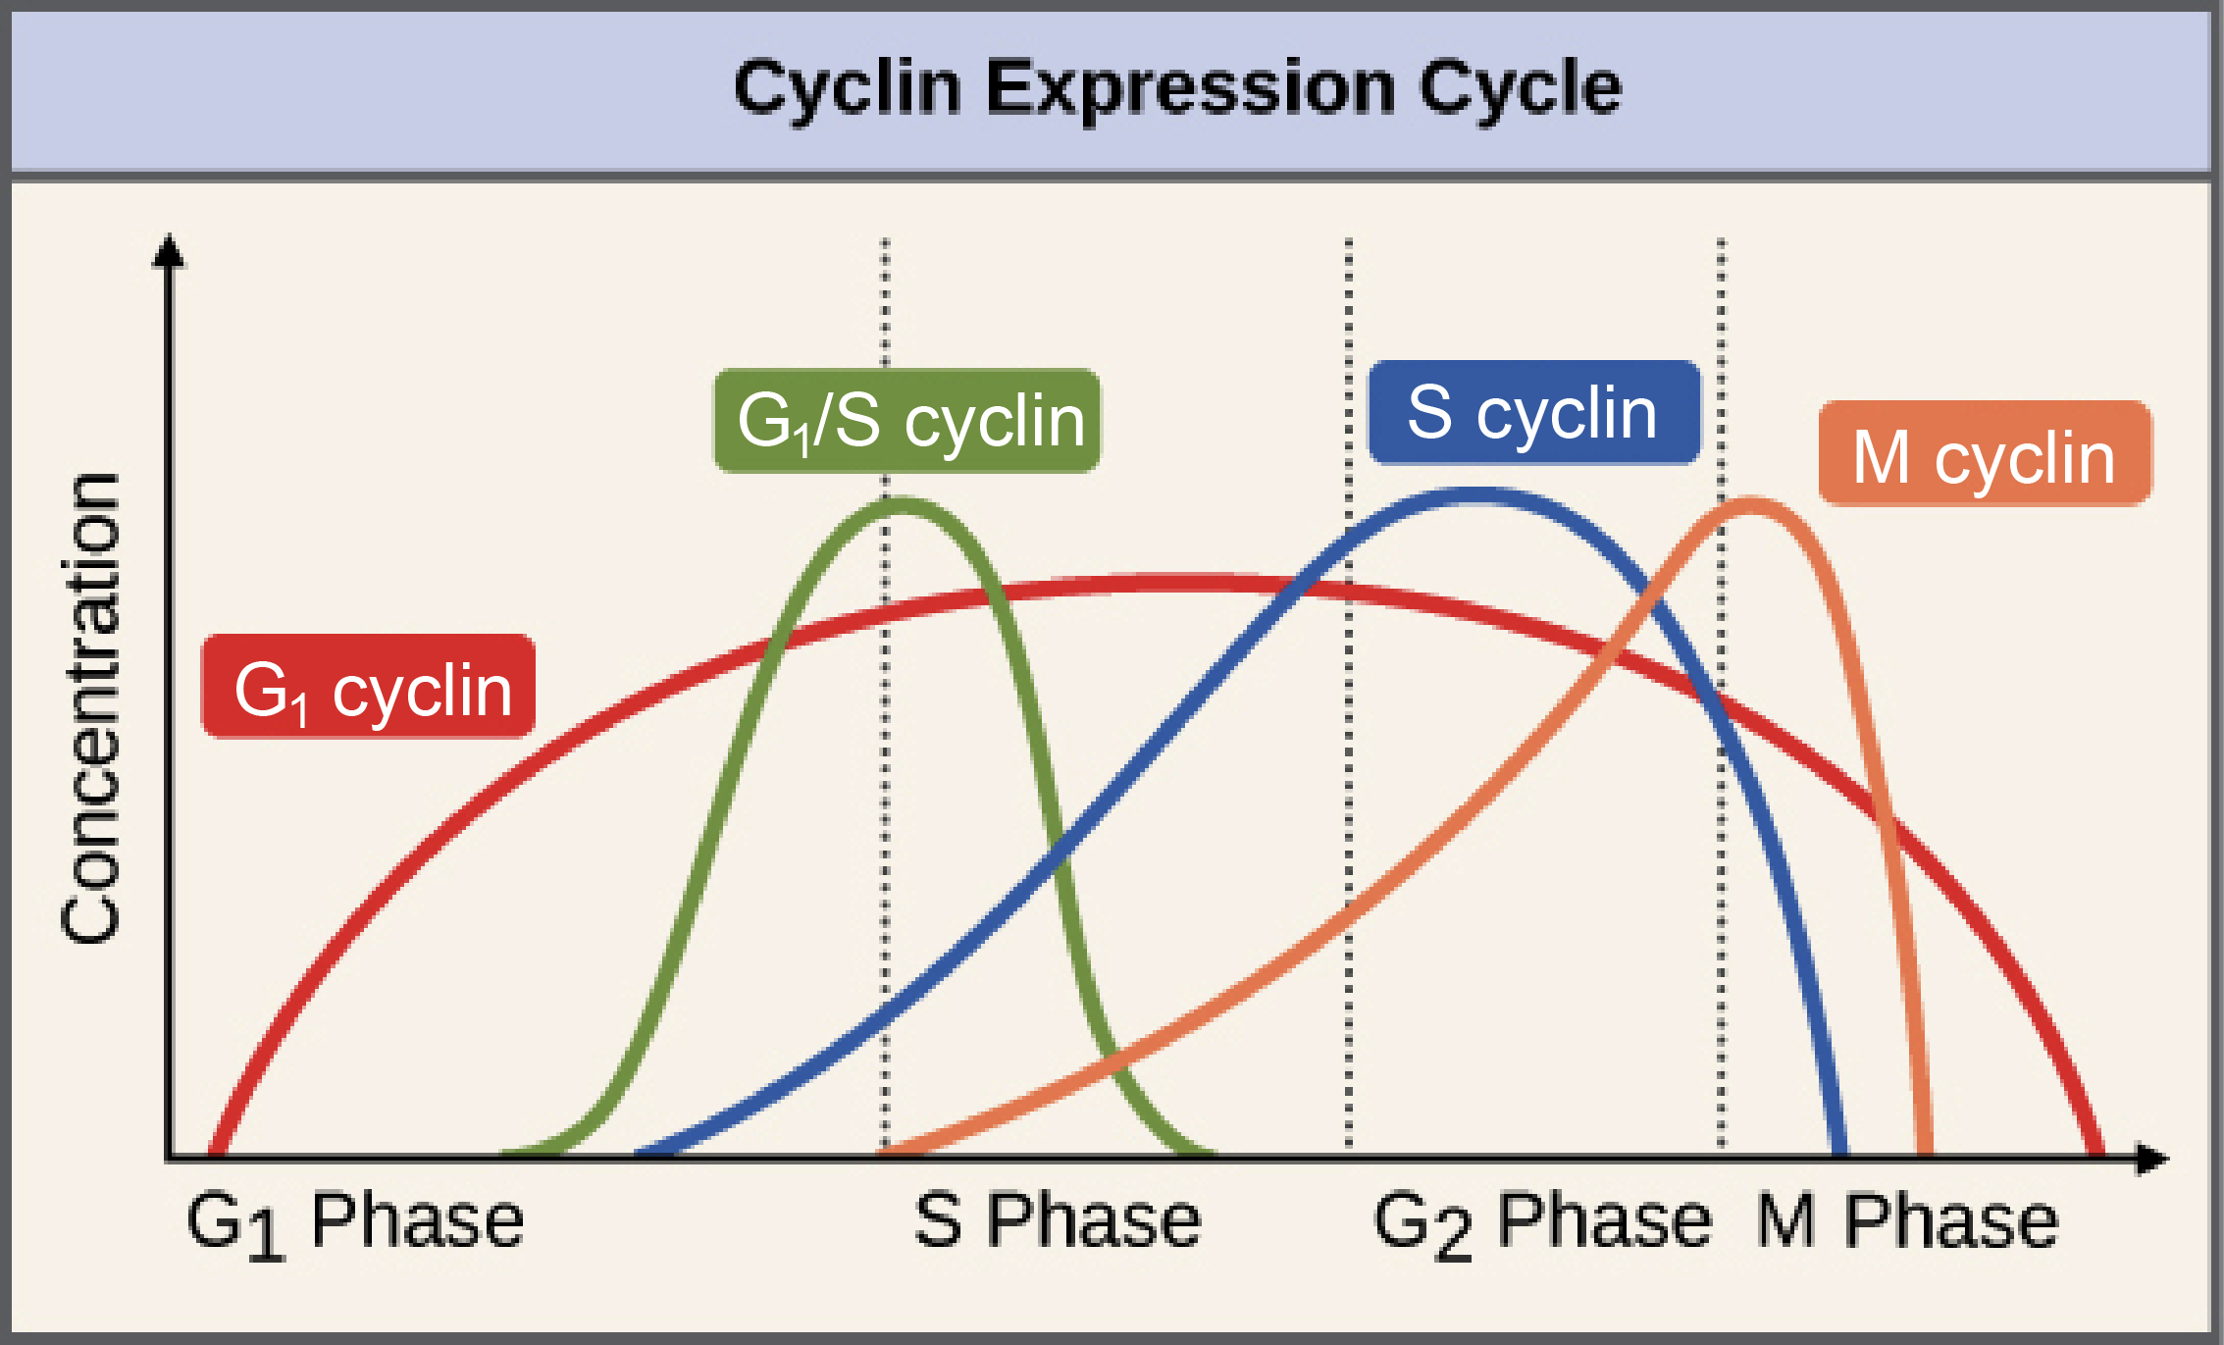
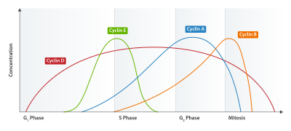
Cell cycle clock: Cyclins & Cyclin-dependent kinases
Cyclins
Regulatory proteins
Levels cycle in the cell

Slide 8
Cell cycle clock: Cyclins & Cyclin-dependent kinases
Cyclins
Regulatory proteins
Levels cycle in the cell
Cdks
Cyclin dependent kinases
Phosphorylates cellular proteins
Activate or inactivate proteins
Domino effect
Cdk-cyclin complex
Triggers passage through stages of cell cycle

Slide 9
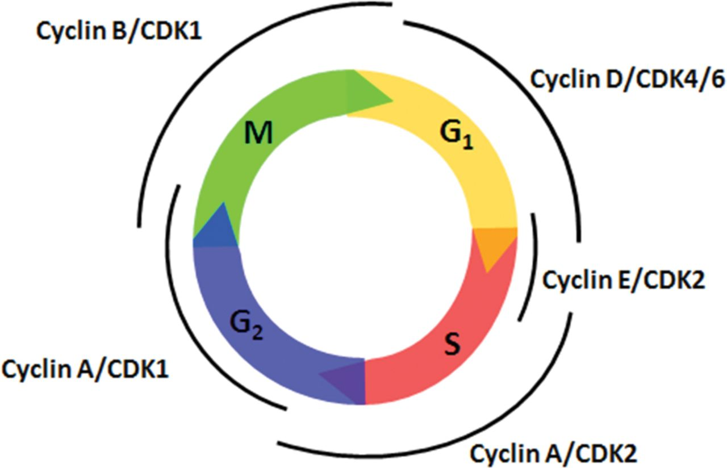
Cell cycle clock: Cyclins & Cyclin-dependent kinases
Master regulators
4 main cyclins:
Cyclin A
Cyclin B
Cyclin D
Cyclin E
4 main CDKs:
CDK1
CDK2
CDK4
CDK6
Each Cyclin pairs with a specific CDK(s)

Slide 10
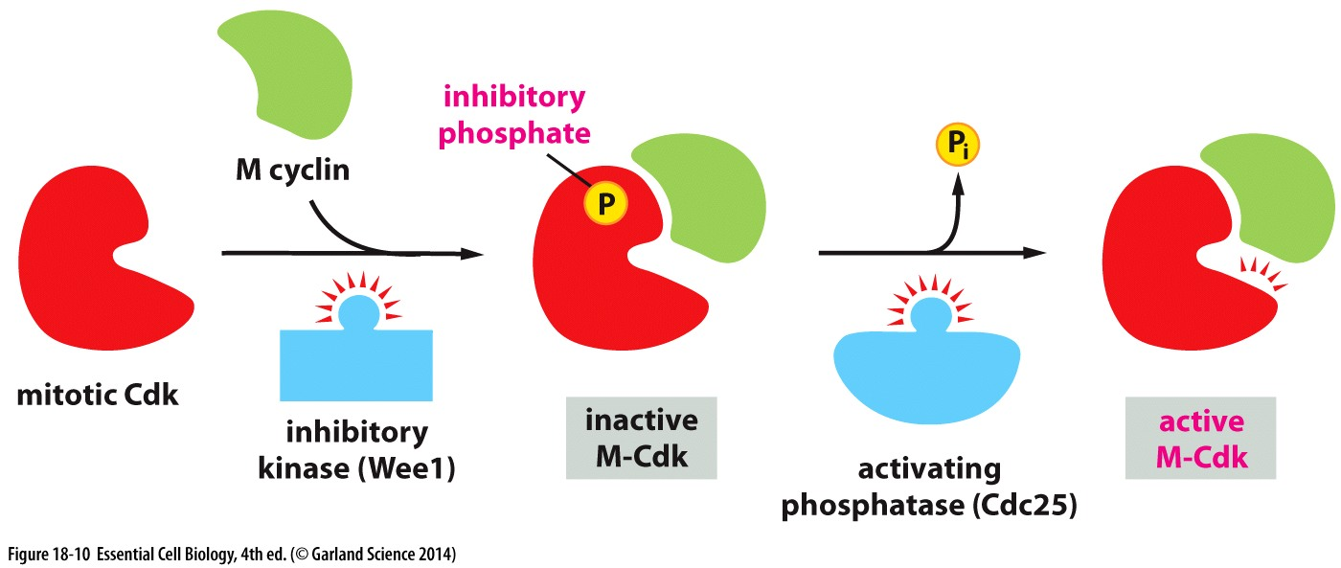
Regulation of CDK activity
CDKs are activated by binding cyclins
Activity of Cyclin-CDK complexes depends on phosphorylation status of the complex
Kinase → places phosphate group
Phosphatase → removes a phosphate group

Slide 11
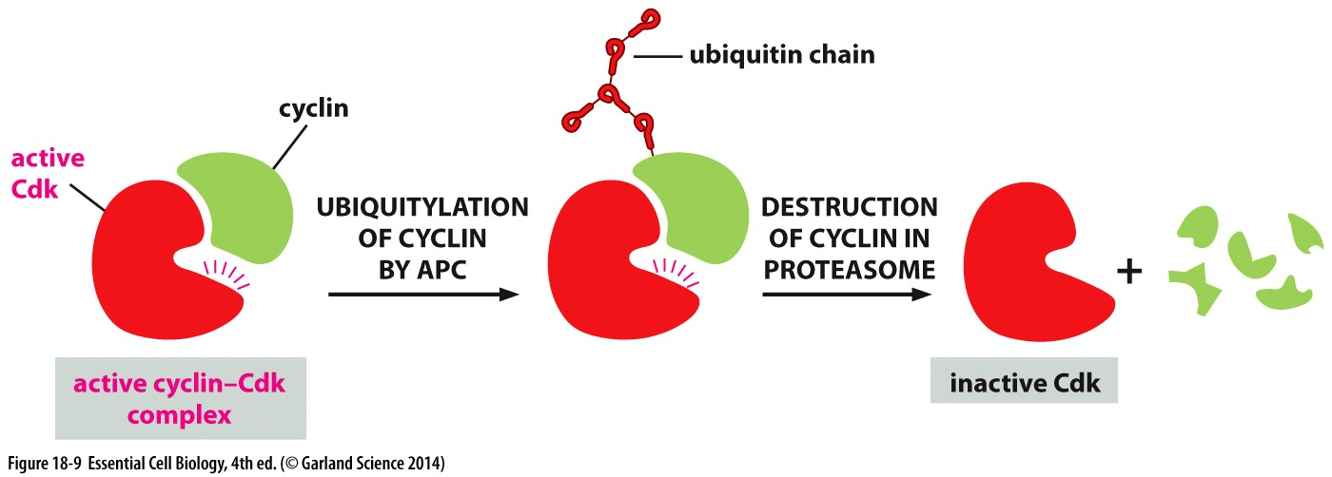
Regulation of CDK activity
Cyclin concentrations are regulated by:
Transcription → mRNA → protein
Proteolysis → targeted for protein destruction

Slide 12
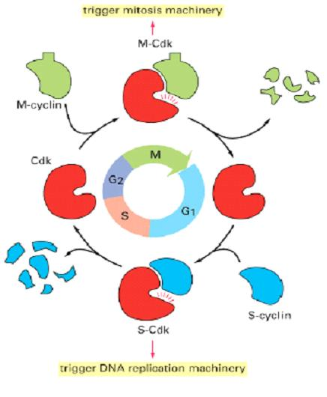
Regulation of CDK activity
Multiple levels of regulation for EACH Cyclin/CDK complexes:
Enables rapid activation of existing complexes (phosphorylation)
Enables rapid and irreversible destruction of complexes (proteolysis)

Slide 13
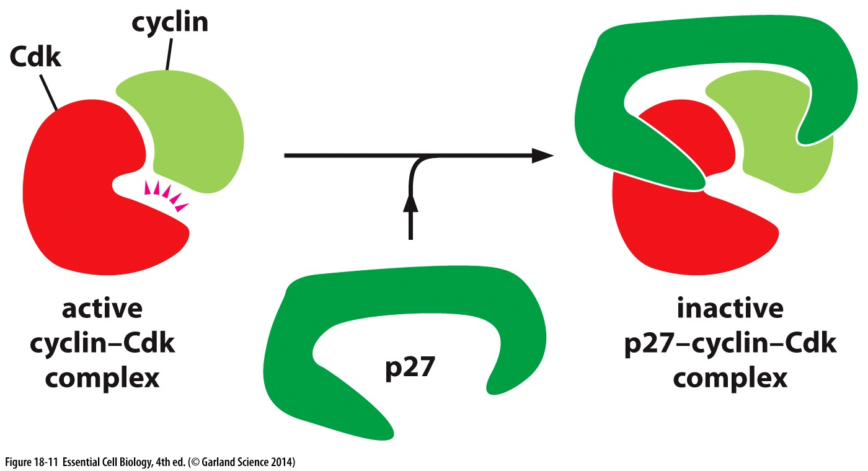
Regulation of CDK activity
Multiple levels of regulation for EACH Cyclin/CDK complexes:
Enables rapid activation of existing complexes (phosphorylation)
Enables rapid and irreversible destruction of complexes (proteolysis)
Tighter regulation allowed by ability to fine-tune or ‘pause’ activity
Aditional co factors
(binding partners) →

Slide 14
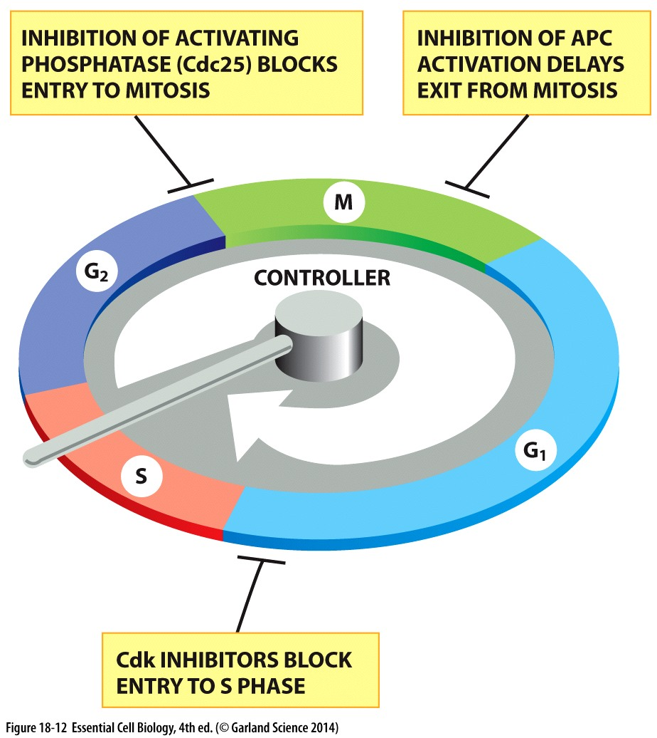
Cell cycle checkpoints depend on inhibition of Cyclin/CDK activity
Release of inhibition allows progression to the next stage
Silencing/satisfaction of checkpoint is irreversible
Consider for each stage:
What is the checkpoint sensing?
How is CDK activity inhibitied?
How is CDK inhibition released?

Slide 15
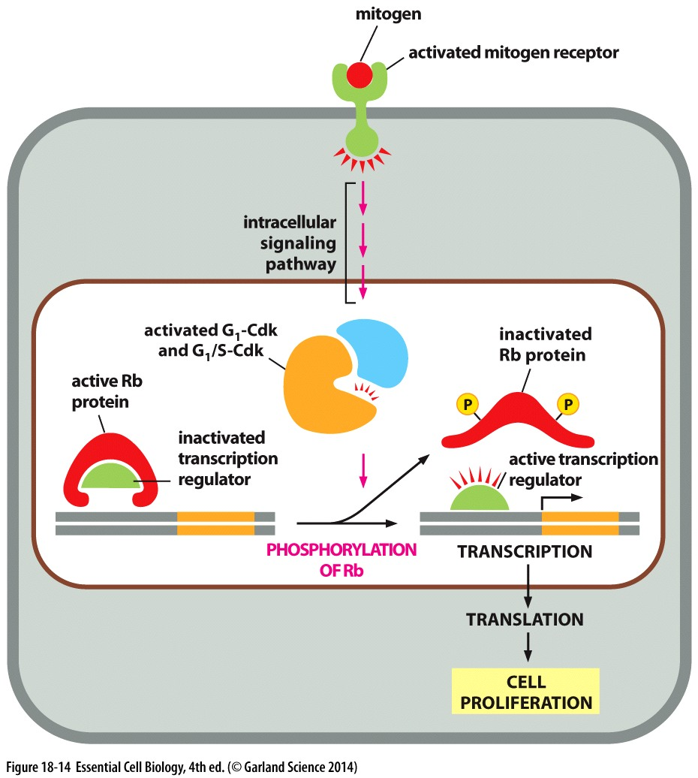
G1: First Gap Phase
Key features
CDKs are inactivated
Mitogens promote production of Cyclins that stimulate cell cycle
2N DNA content: 46 chromosomes
Checkpoint
Cell growth?
Nutrient availability/favorable environment?
Mitogens present?

Slide 16
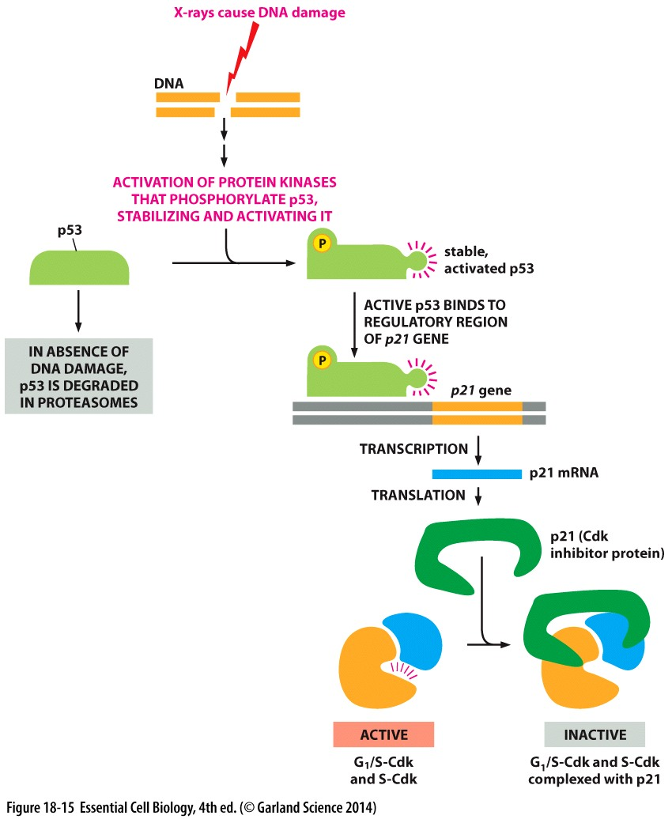
G1: First Gap Phase
Key features
CDKs are inactivated
Mitogens promote production of Cyclins that stimulate cell cycle
Checkpoint
Cell growth?
Nutrient availability/favorable environment?
Mitogens present?
DNA damage?
→ poised for DNA synthesis to begin!

Slide 17
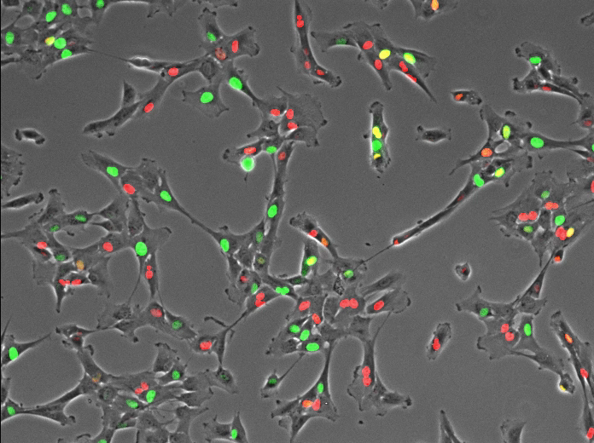
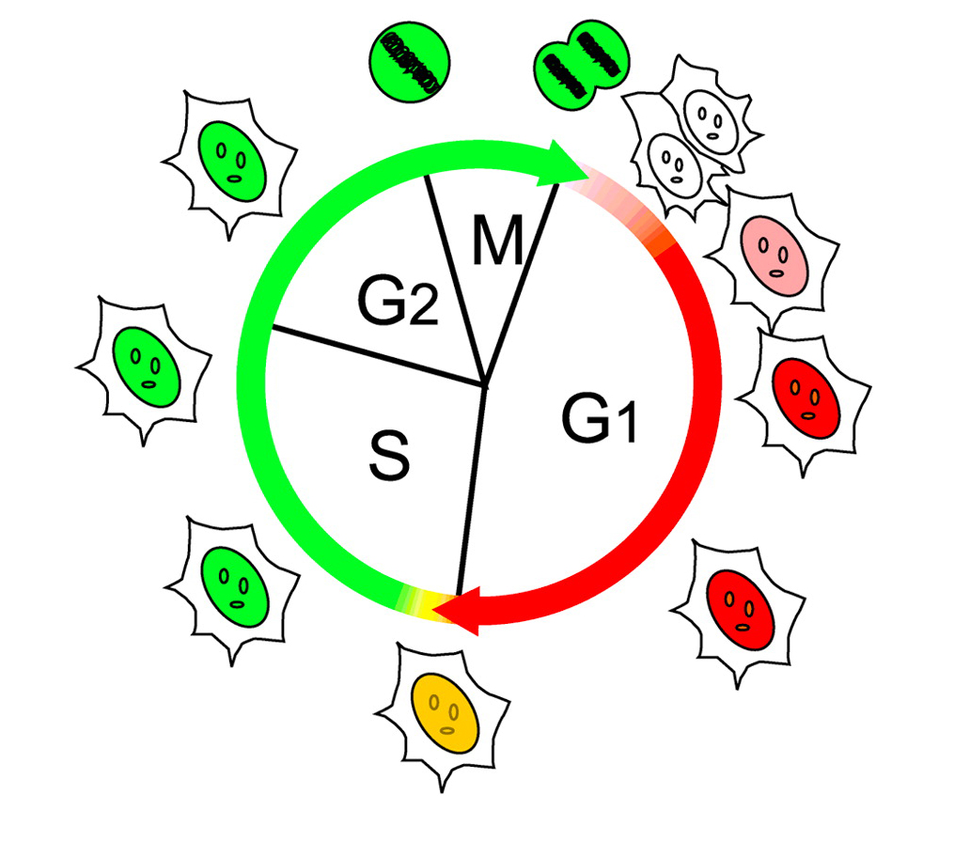
Cell cycle checkpoints at work
Normal cells cycle from red to green as they progress through cell cycle

Slide 18
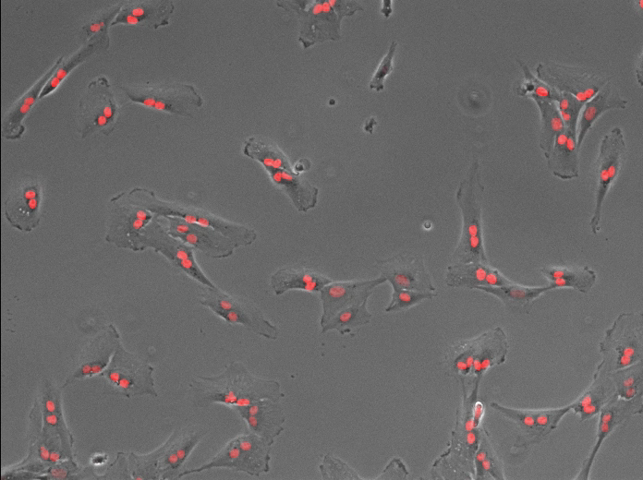
Cell cycle checkpoints at work
+ Damage
Brakes are on!
Checkpoints are activated when something goes wrong
When cells are damaged, they arrest in the subsequent cell cycle (red)

Slide 19
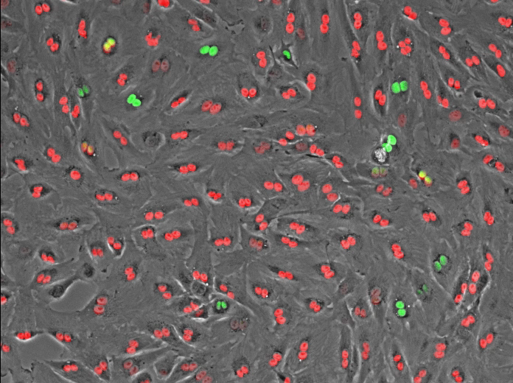
Cell cycle checkpoints at work
Damaged cells
Damaged Cells with
Compromised Checkpoint
Brakes are on
Brakes are faulty!
When the checkpoint is compromised, damaged cells continue to cycle from red to green
The ability to bypass checkpoints is a feature common in cancer cells

Slide 20
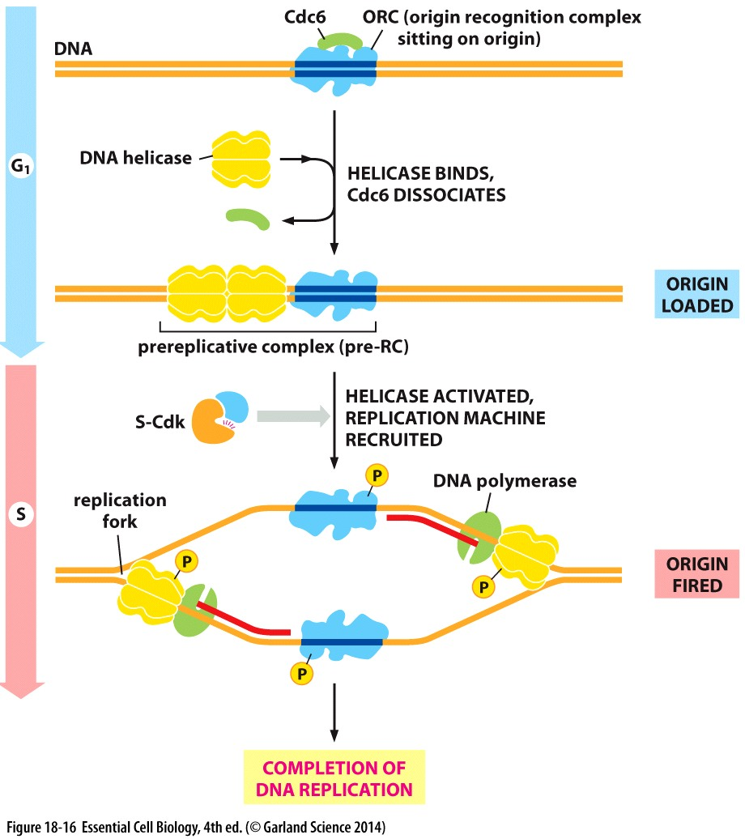
S: Synthesis Phase
Key features
DNA replication is initiated
Degradation of licensing factors (Cdc6) prevent re-replication
Centrosomes are duplicated
Checkpoint
No clear checkpoint from S→G2

